Slide 1
E-mechanic

Slide 2




Team members
Usama Latif
Zain Amjad
Tayeba Tariq
Muqaddas Rashid

Slide 3
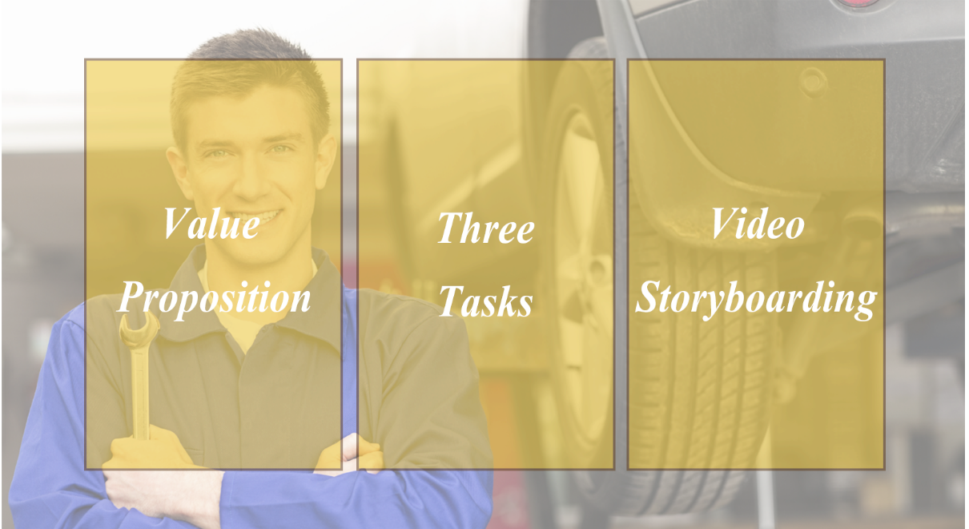

Slide 4
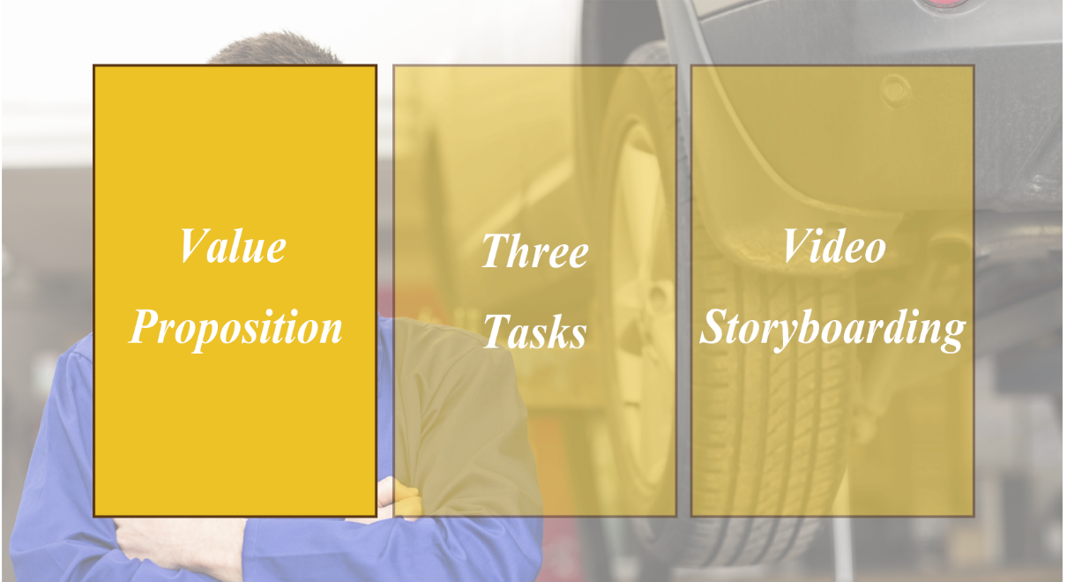

Slide 5

Value proposition – “Solving problem of bike maintenance due to time shortage”
Most of the people in our country use motor bikes as a mode of transportation so called two-wheelers. As they ride their bikes but most often they do not find time for the maintenance of their bikes which ultimately leads to severe bike issues during travel. So, e-mechanic is providing a solution to solve the problem of bike maintenance at their doorsteps and in long term e-mechanic will be providing on road service as well.

Slide 7
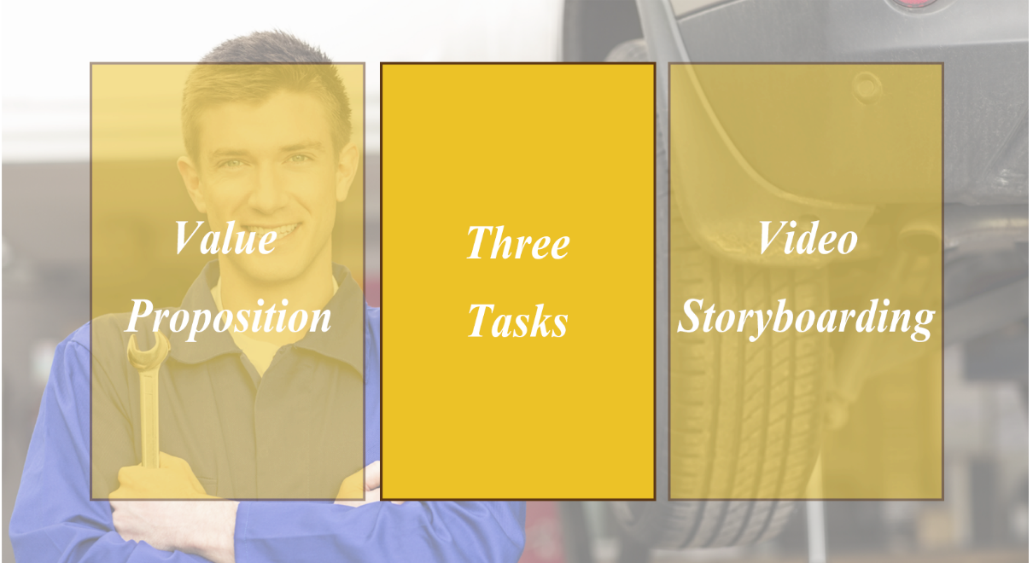

Slide 8
Three tasks
Simple: A customer who wants to check services which e-mechanic is providing.
Moderate: A customer wants to check the rates of the services he wants to avail for his motorbike maintenance.
Complex: Customer booking a service according to his free time and day for his bike maintenance.

Slide 10
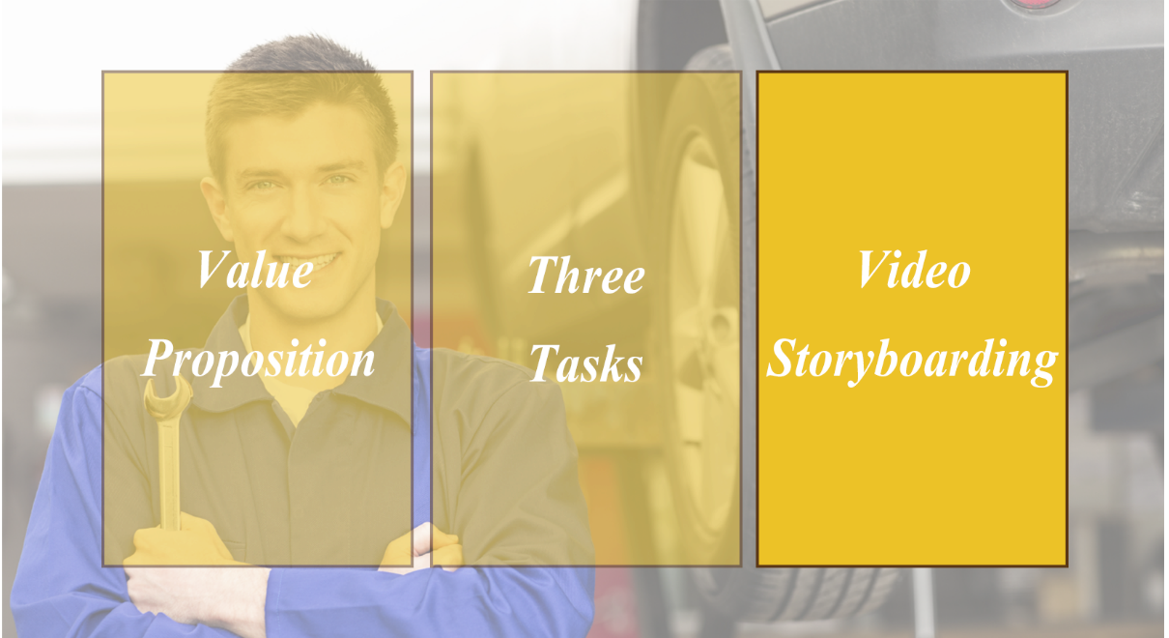

Slide 11
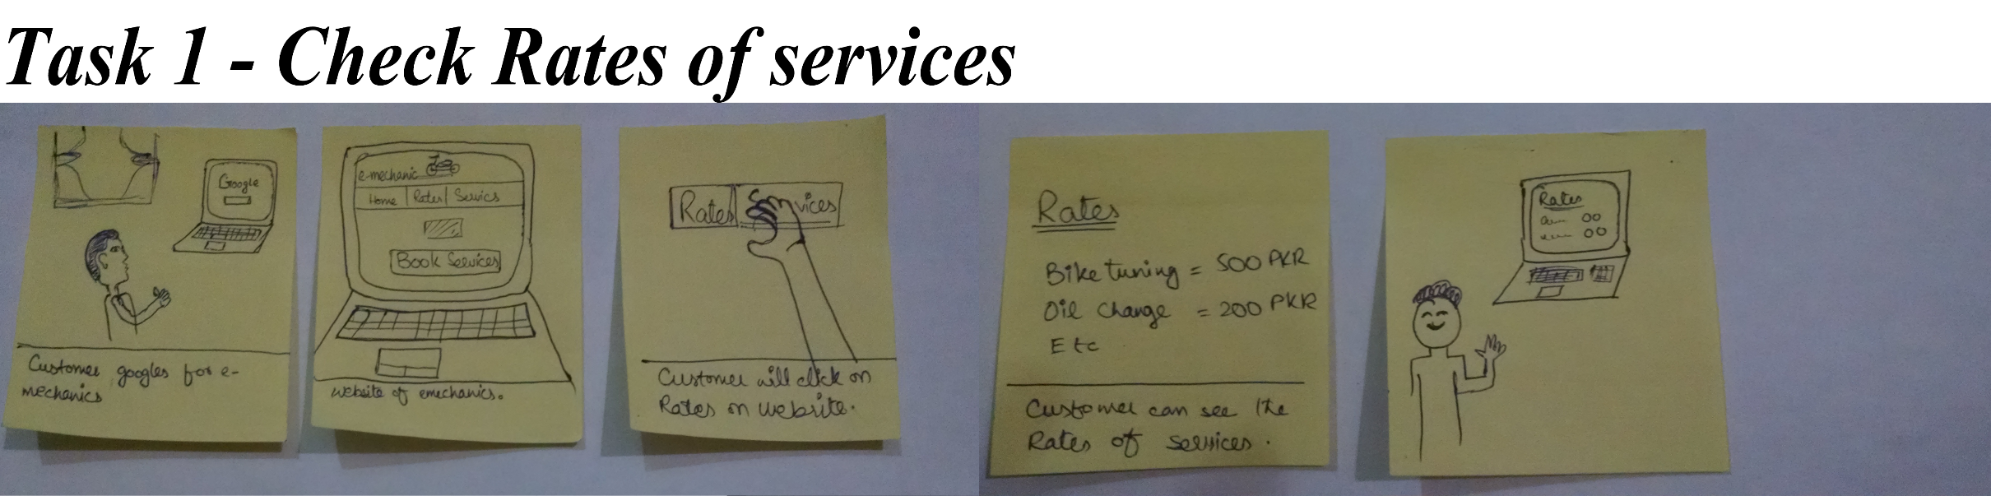
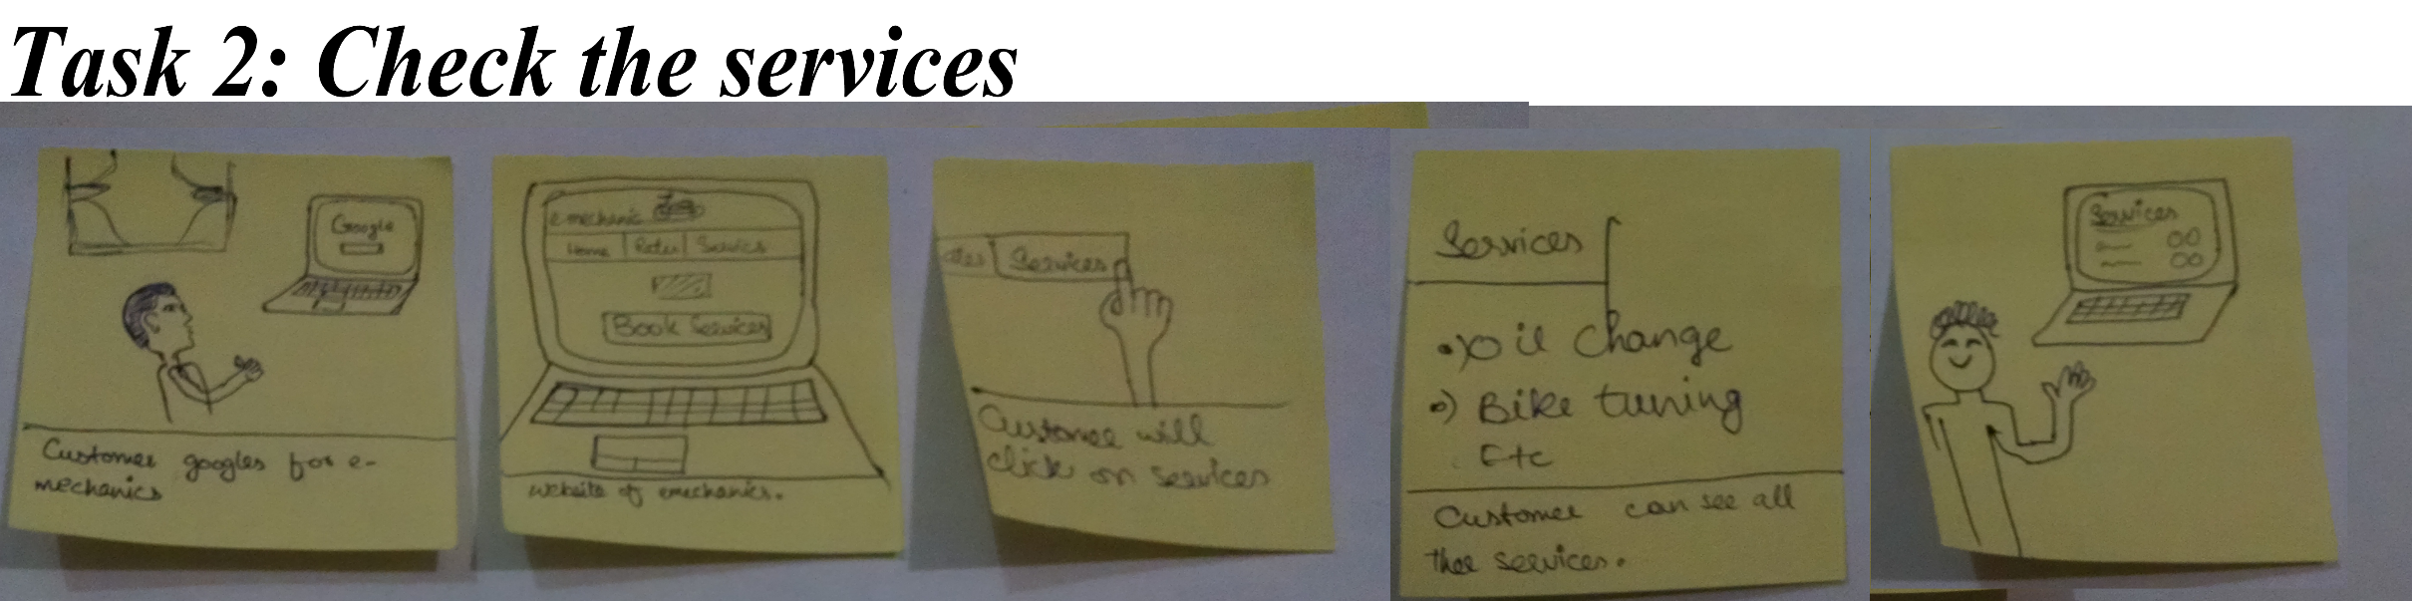
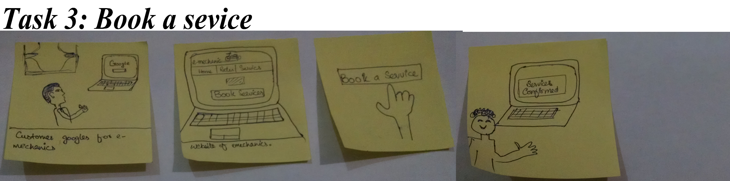
Video Storyboarding
**Video link: https://www.youtube.com/watch?v=tealuCLZZk4&feature=youtu.be

Slide 12
Thank -you

